Slide 1
CSE 4128 Lab 2
Topic: Smoothing Using Bilateral Filter
Dr. Sk. Md. Masudul Ahsan Professor
Dept. of Computer Science and Engineering KUET
Dipannita Biswas
Lecturer
Dept. of Computer Science and Engineering KUET

Slide 2
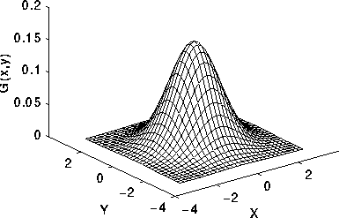
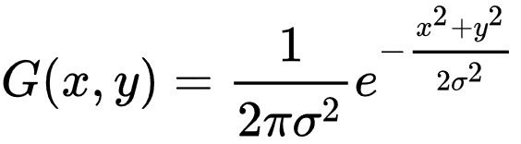
Gaussian Function
where x is the distance from the origin in the horizontal axis, y is the distance from the origin in the vertical axis, and σ is the standard deviation of the Gaussian distribution.
2-D Gaussian distribution with mean (0,0) and σ =1

Slide 3
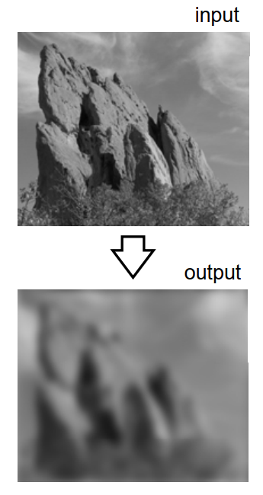
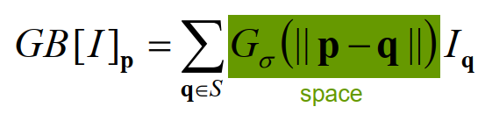
Properties of Gaussian Blur
While smoothing:
Edges are blurred
Only Spatial distance matters

Slide 4
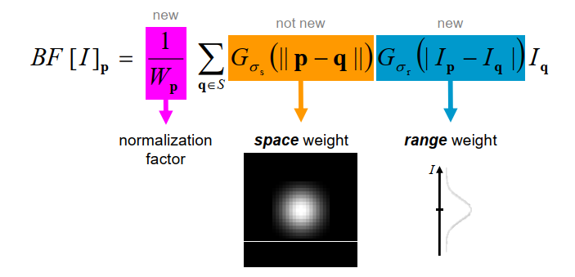
Bilateral Filter
A bilateral filter is a non-linear, edge-preserving, and noise-reducing smoothing filter for images. It replaces the intensity of each pixel with a weighted average of intensity values from nearby pixels

Slide 5
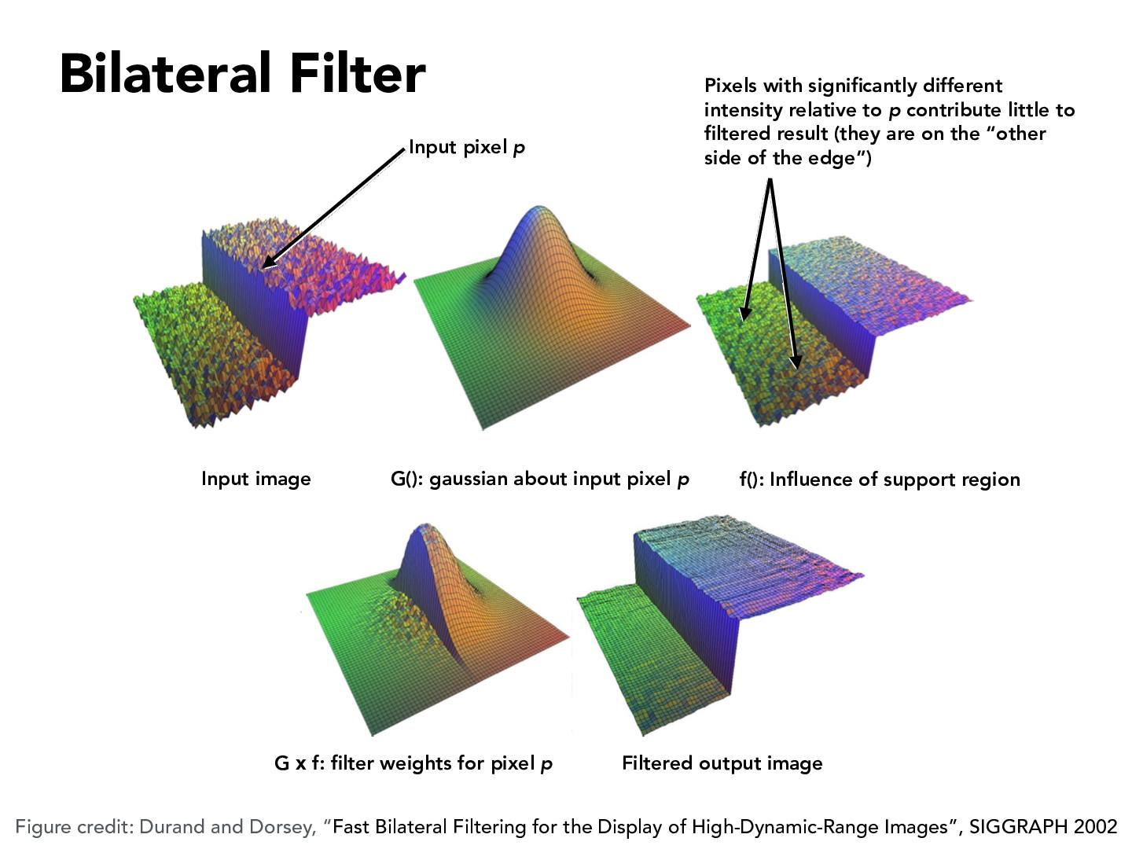

Slide 6
Bilateral Filter
cv2.bilateralFilter ( src, dst, d, sigmaColor, sigmaSpace, borderType = BORDER_DEFAULT )

Slide 7
Homework
Convolution as Matrix Multiplication

Slide 8
Convolution as Matrix Multiplication
1. Define Input and Filter
1
2
3
10
20
4
5
6
30
40
Input image
Filter

Slide 9
Convolution as Matrix Multiplication
2. Calculate the final output size
If the Input is m1 x n1 and Filter is m2 x n2 the size of the output will be:
( m1 + m2 - 1) x ( n1 + n2 - 1)
For our example it’s : (2 + 2 - 1) x (3 + 2 - 1)
= 3 x 4

Slide 10
Convolution as Matrix Multiplication
3- Zero Pad the filter matrix
Zero pad the filter to make it the same size as the output.
Zero padded F =
0
0
0
0
10
20
0
0
30
40
0
0

Slide 11
Convolution as Matrix Multiplication
4- Create Toeplitz matrix for each row of the zero-padded filter
0
0
0
0
Zero padded F =
10
20
0
0
30
40
0
0
30
0
0
10
0
0
0
0
0
40
30
0
20
10
0
0
0
0
0
40
30
0
20
10
0
0
0
0
0
40
0
0
20
0
0
0
F0
F1
F2

Slide 12

Convolution as Matrix Multiplication
5- Create a doubly blocked Toeplitz matrix
Now all these small Toeplitz matrices should be arranged in a big doubly blocked Toeplitz matrix.

Slide 13
Convolution as Matrix Multiplication
30
0
0
0
0
0
40
30
0
4
0
0
0
0
40
30
0
0
0
5
0
0
40
0
0
0
10
0
0
30
0
0
Doubly Blocked =
6
20
10
0
40
30
0
0
20
10
0
40
30
1
0
0
20
0
0
40
0
0
0
10
0
0
2
0
0
0
20
10
0
3
0
0
0
0
20
10
0
0
0
0
0
20

Slide 14
Convolution as Matrix Multiplication
6- Convert the input matrix to a column vector
4
5
1
2
3
Vectored
I =
I =
6
4
5
6
1
2
3

Slide 15
Convolution as Matrix Multiplication
7- Multiply doubly blocked Toeplitz matrix with vectorized input signal
This multiplication gives the convolution result.

Slide 16
8- Last step: reshape the result to a matrix form
120
310
380
10
40
70
60
240
70
230
330
240
70
120
310
380
240
230
Output
330
Result Vector
240
10
40
70
60

